Slide 1

Soil Moisture Prediction using Integrated Supervised and Unsupervised Machine Learning Algorithms:
Application to Precision Agriculture
CP303 - CAPSTONE PROJECT II
Supervisor:
Dr. Jayaram Valluru
Presented by:
Rahul Kumar Saw (2021CHB1052)

Slide 2
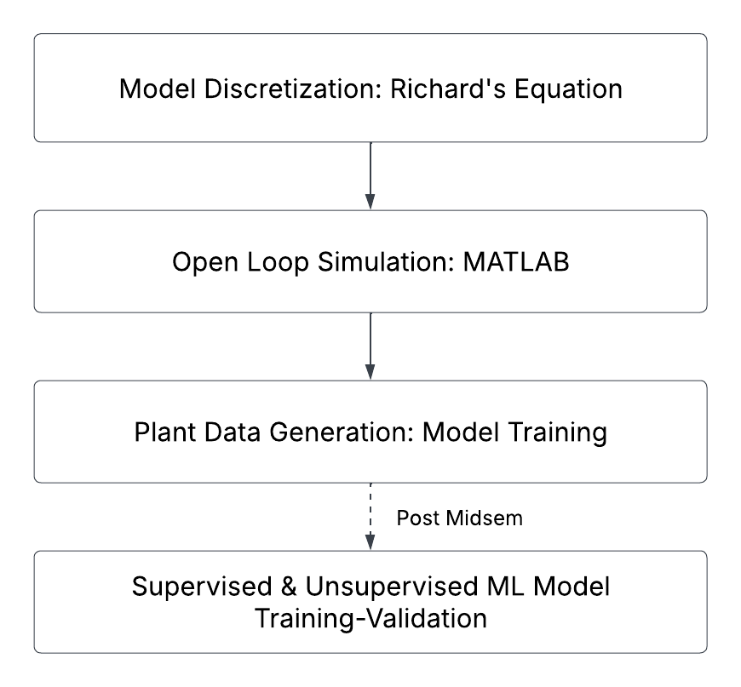
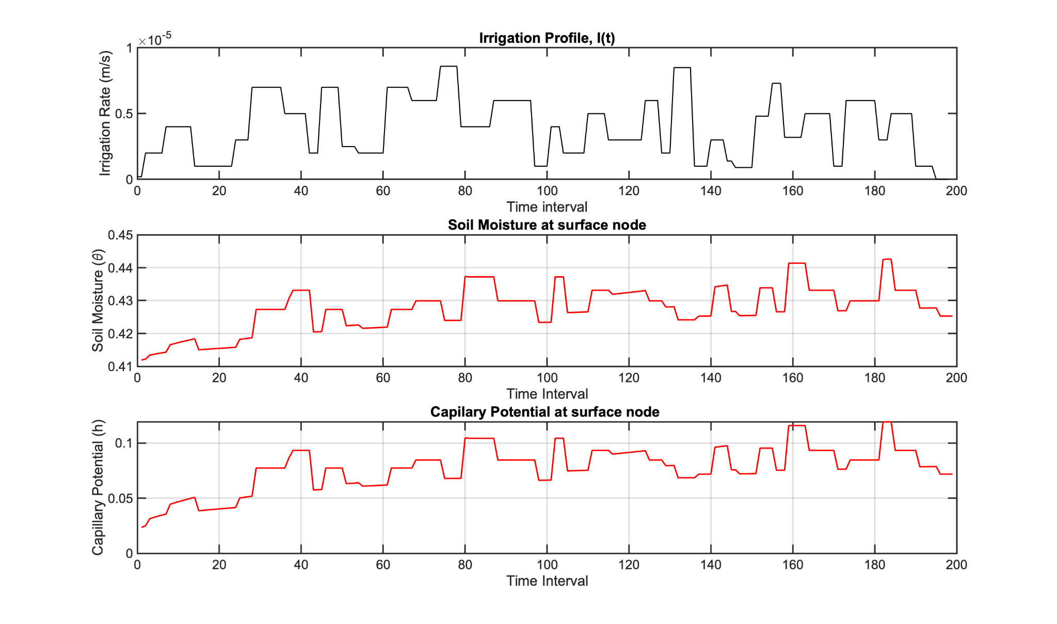
Upto Midsem: Recap
Notes:
This problem is growing worldwide, and one of the biggest factors is how we use water in agriculture.
Did you know that farming uses about 70% of all our freshwater? That’s a huge amount, which is why improving how we use water in agriculture is so important.
Currently, most irrigation systems are what we call ‘open-loop’. This means farmers often rely on experience or guesswork to decide when and how much to water their crops. They’re not using real-time information from the fields.
The problem with this approach is that it’s not very efficient. Sometimes crops get too much water, and sometimes not enough. This wastes water and can affect crop yields.
Our goal is to find smarter ways to irrigate. We want to develop systems that use real-time data to make better decisions about watering. This could significantly improve water efficiency in agriculture and help address the global water scarcity issue.
In the next part of our presentation, we’ll look at some innovative solutions to this challenge.

Slide 3
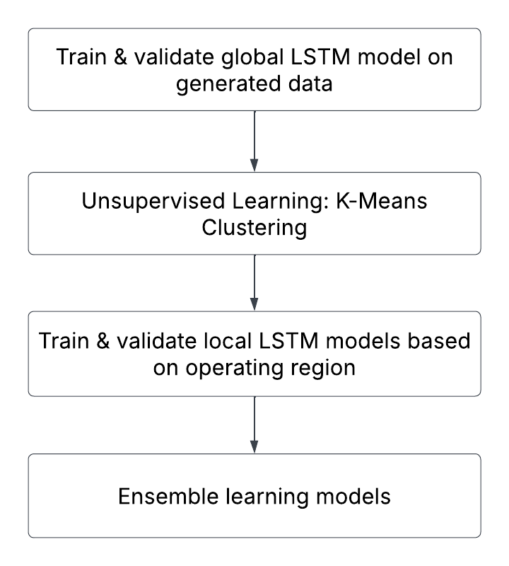
Objective
Dataset:
Input feature: Irrigation Rate
Output feature: Soil Moisture
Tools & Technology used:
Python, MATLAB
Libraries/packages: Numpy, Pandas, Scikit Learn, MatPlotLib, tensorflow, optimization toolbox
Notes:
First Step - generation of molecular descriptors or fingerprints from chemical structures using SMILES.
SMILES - to represent chemical compounds
SMILES (Simplified Molecular Input Line Entry System)
2nd Step - Calculating the molecular descriptors using SMILES notations.
Pubchem FP - binary vector of fixed length where each bit represents the presence (1) or absence (0) of particular structural feature or pattern within the molecule.
3rd Step - using the desired molecular descriptors to predict the target variable.

Slide 4
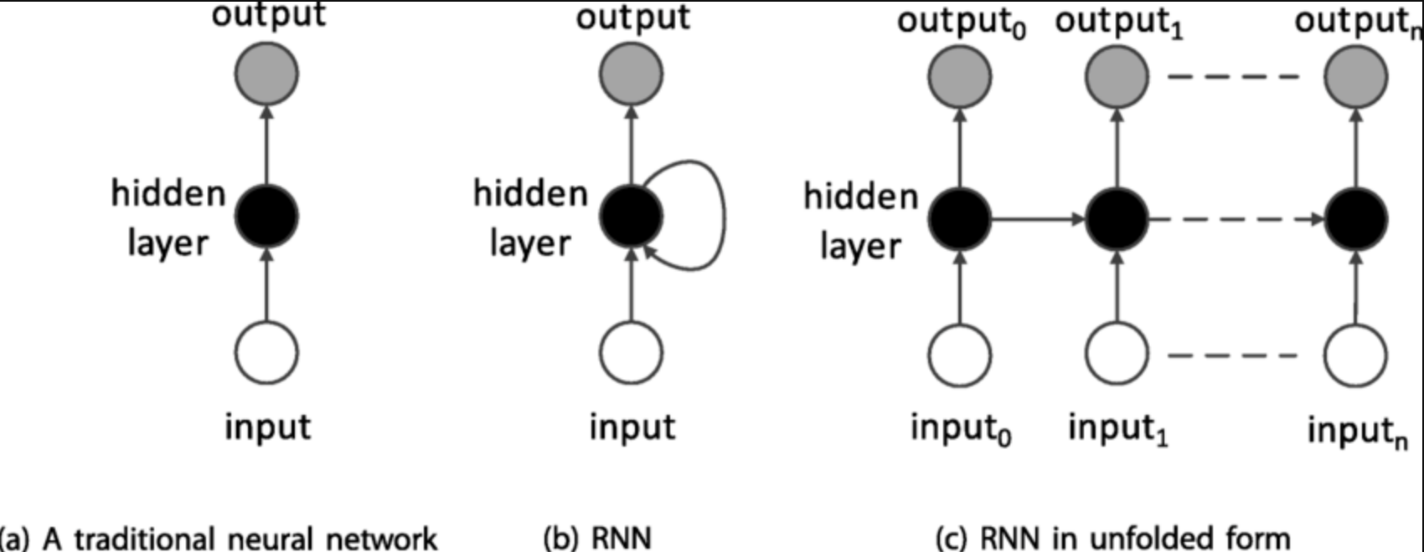
Traditional Neural Networks vs RNNs
Traditional NNs:
“Each input processed independently”
can’t remember past inputs: lacks Memory
Image classification, tabular data prediction
RNNs:
“process one element at a time, remembering what they saw before”
have recurrent connections: Short term memory
Time Series Forecasting, Language Modelling
https://www.researchgate.net/publication/330323646_Automatically_learning_usage_behavior_and_generating_event_sequences_for_black-box_testing_of_reactive_systems
Traditional NNs are memoryless; RNNs introduce short-term memory, enabling sequence learning.
Notes:
Reference Trajectory (Red Line): Represents the desired soil moisture level or target range for optimal crop growth.
Measured Output (Yellow Dots): The actual soil moisture levels measured in real time using sensors in the field.
Predicted Output (Orange Line): The soil moisture levels predicted by the MPC model based on current conditions and control inputs.
Predicted Control Input (Blue Steps): The irrigation actions (e.g., water amount) calculated by MPC to achieve the desired soil moisture levels while staying within constraints.
Past Control Input (Black Line): The irrigation actions that have already been applied in previous time steps.
Prediction Horizon: he future time window over which MPC predicts and optimizes soil moisture dynamics.
Sample Time: The interval at which new measurements are taken, predictions are updated, and control inputs are recalculated. How It Works in Precision Agriculture At each time step , MPC collects real-time data from soil moisture sensors (yellow dots).
Using this data, it predicts how the soil moisture will change over the prediction horizon (orange line).
Based on these predictions, MPC calculates the optimal irrigation actions (blue steps) to bring the soil moisture closer to the reference trajectory (red line).
These actions are applied to the field, and the process repeats at the next sample time.
Real-Time Feedback: MPC continuously adjusts irrigation based on real-time sensor data.
Efficiency: By predicting future conditions, it avoids over-irrigation or under-irrigation.
Adaptability: It accounts for weather changes and other disturbances.
Optimization: Ensures water use is minimized while maintaining optimal soil conditions for crop growth. Model approximation techniques: 1. project the high dimension original state space onto a lower dimension subspace (physical meaning of the original states are not preserved)
2. Data-based model identification methods (no first principal relations required) 3. Neural Network based optimization (Long Short Term Memory, LSTM ability to capture the complex dynamics of the system) Ultimate goal of the project: Propose a two layer Neural Network framework to approximate the agro-hydrological dynamics

Slide 5
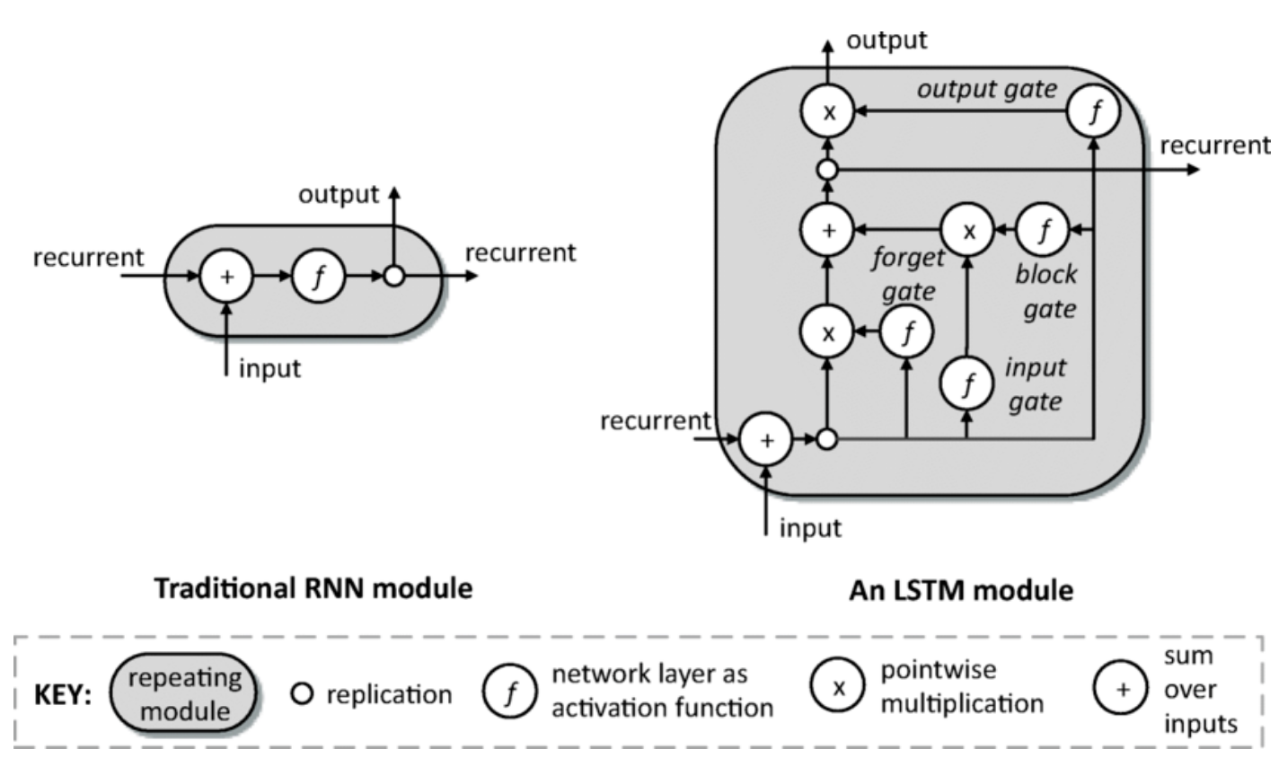
Long Short Term Memory (LSTM):
A special type of RNN designed to remember long-term dependencies.
.
Architecture:
Forget gate: Decides what to discard
Input gate: Decides what new info to store
Output gate: Controls what to output
Used in NLP, Speech recognition,
Time series forecasting
LSTMs are like “smart memory cells” that decide what to remember and forget, making them ideal for complex time-based problems.
https://www.researchgate.net/figure/Traditional-RNNs-vs-LSTM-networks_fig3_330323646

Slide 6
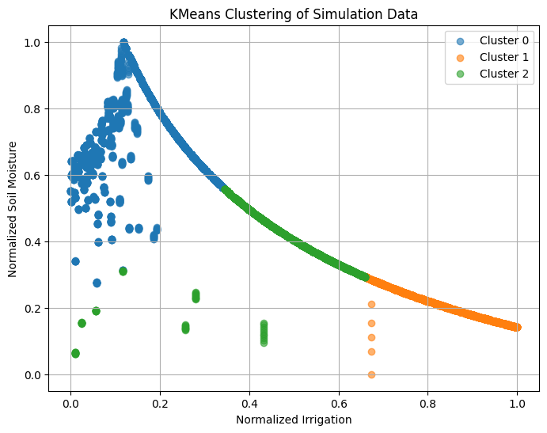
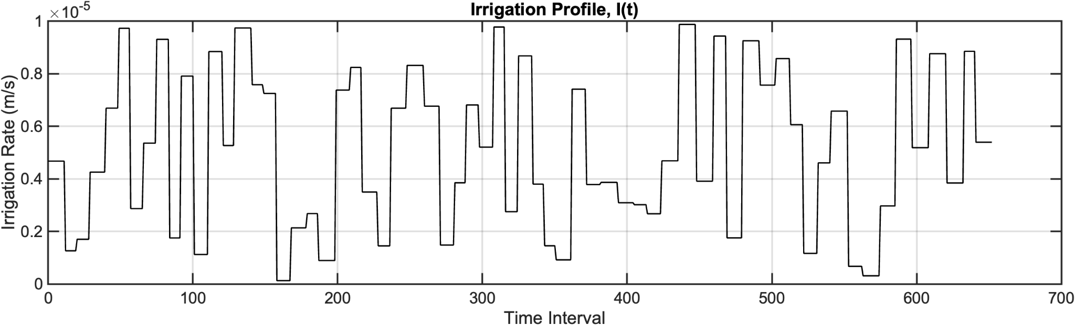
K-Means Clustering
Unsupervised learning algorithm
Partition data into K distinct, non-overlapping clusters based on feature similarity - irrigation rate
Captures different operating region

Slide 7
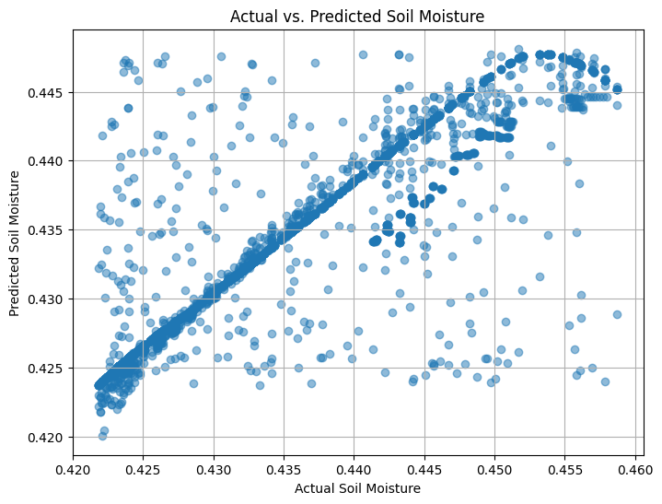
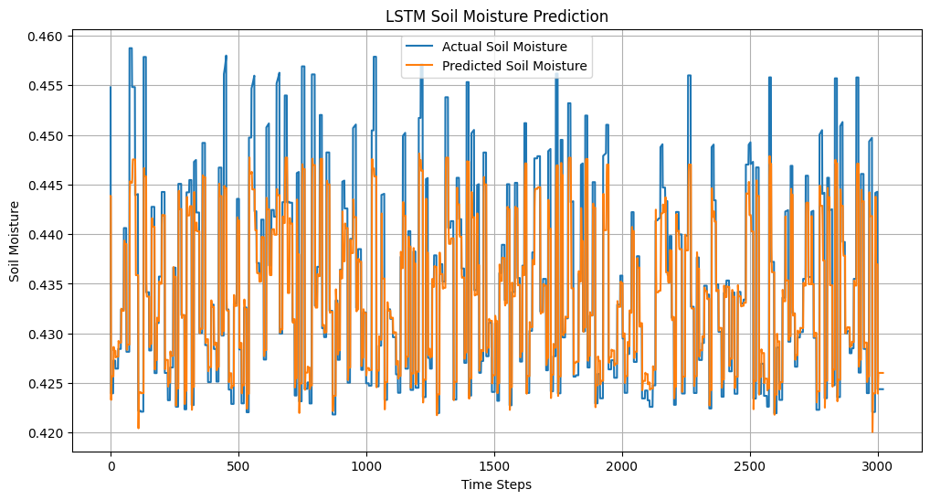
Results: Global LSTM
Performance Metrics:
Mean Absolute Error (MAE): 0.0032 Root Mean Squared Error (RMSE): 0.0054 R² Score: 0.7168

Slide 8
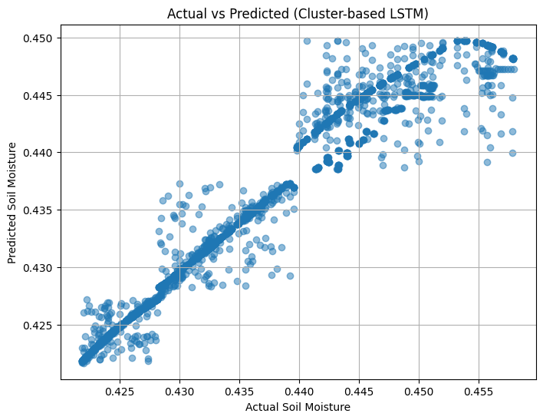
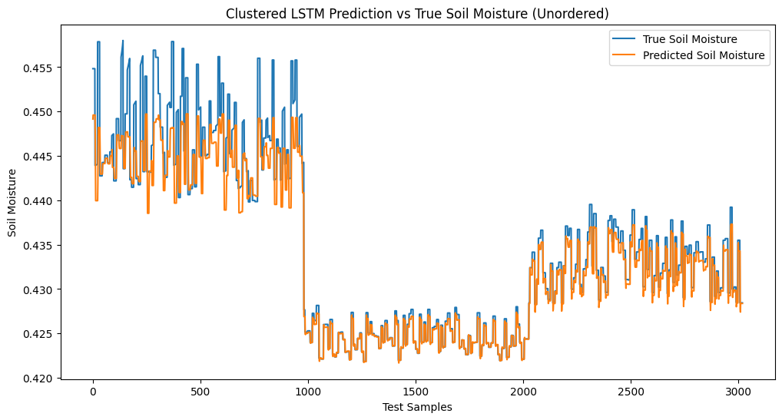
Results: Clustered LSTMs
Performance Metrics:
Mean Absolute Error (MAE): 0.0016 Root Mean Squared Error (RMSE): 0.0027 R² Score: 0.9249

Slide 9
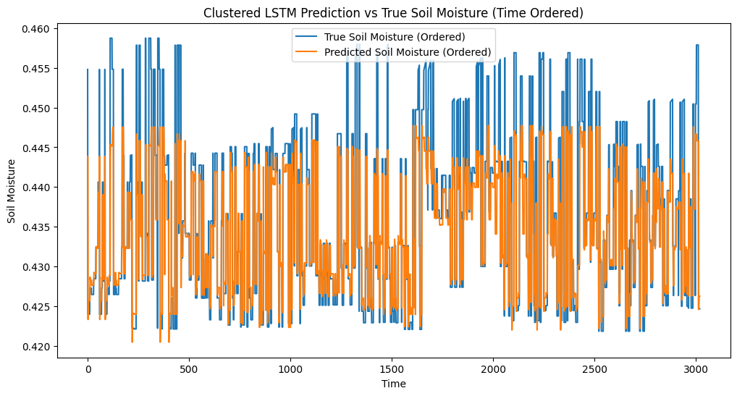
Comparison: Local LSTM vs Global LSTM
Global LSTM Model
Clustered LSTM Model
R² Score: 0.7168
R² Score: 0.9249

Slide 10
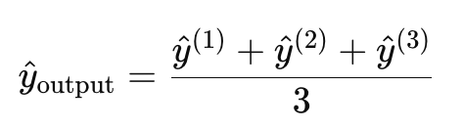
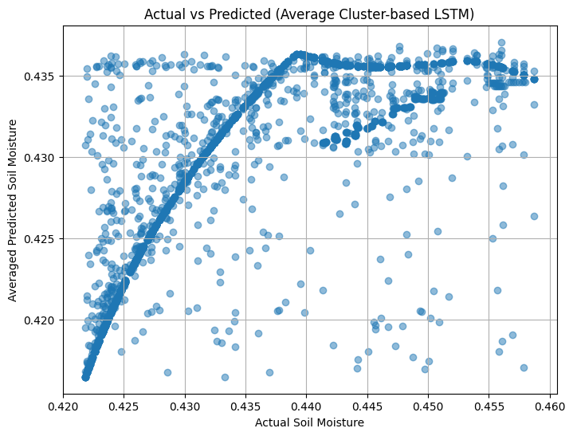
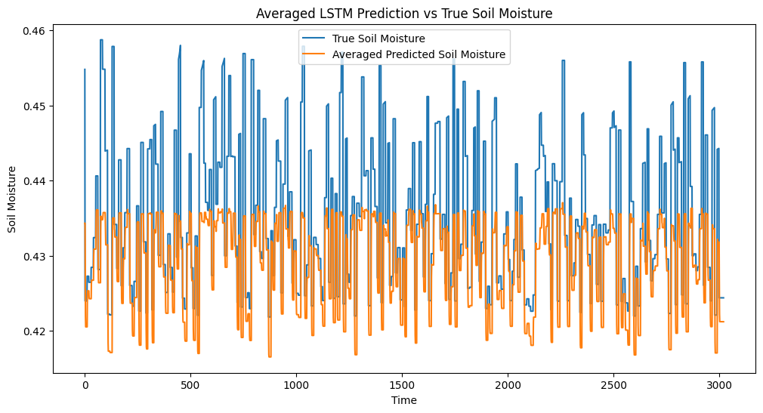
Results: Average Ensembled
Performance Metrics:
Mean Absolute Error (MAE): 0.0064 Root Mean Squared Error (RMSE): 0.0090 R² Score: 0.2024

Slide 11
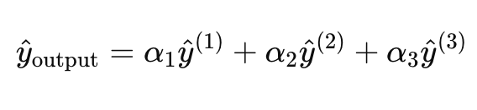
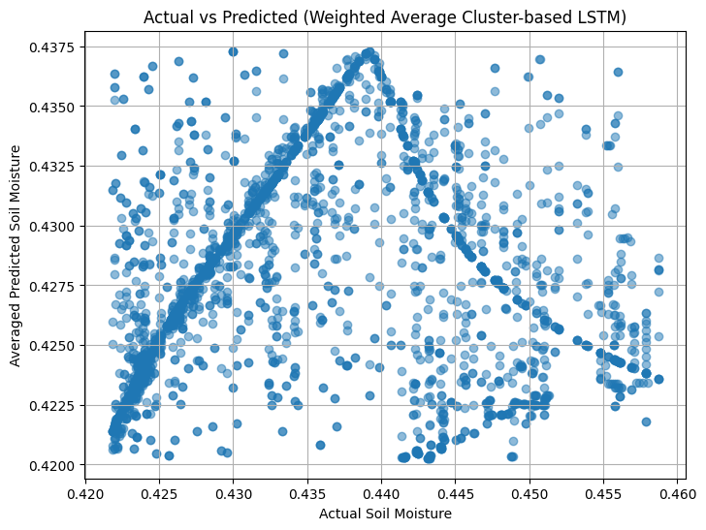
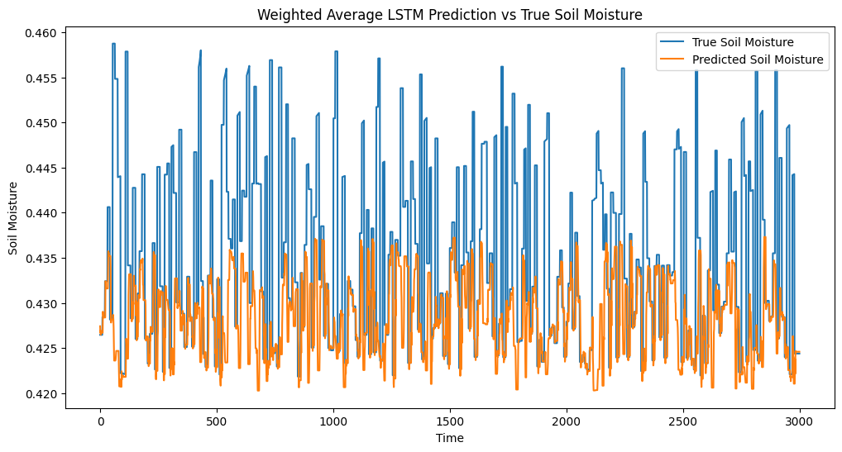
Results: Weighted Average Ensembled
α1​ + α2​ + α3 ​= 1
Performance Metrics:
Mean Absolute Error (MAE): 0.0081 Root Mean Squared Error (RMSE): 0.0128 R² Score: -0.6018

Slide 12
Performance Analysis
R² Score is statistical measure of how well the model predictions approximate the real data points.
Observation:
K-Means clustering grouped similar irrigation–soil moisture patterns into clusters, each representing a unique operating region.
The Global LSTM had to learn from the entire dataset, struggling with high variability and conflicting trends across different regions.
Models | R² Scores
Global LSTM Model | 0.7168
Clustered LSTM Model | 0.9249
Average Ensembled Model | 0.2024
Weighted Average Ensemble Model | -0.6018

Slide 13
Conclusion & Future Work
In summary:
KMeans clustering enabled segmentation of data into homogeneous regions, to handle variability in irrigation-soil moisture dynamics.
Cluster-specific LSTM models effectively captured local temporal patterns, significantly boosting prediction accuracy (R²: 0.7168 → 0.9249).
Compared to ensemble methods, this clustering-based approach delivered the best performance, showing the importance region based modeling.
Future work:
In the dynamic weighted ensemble model, prediction accuracy can be improved by choosing an optimal window size.
A dynamic mechanism to detect changes in operating regions can help adapt window boundaries or update model weights more effectively.
Clustering can be enhanced by including temporal features, statistical insights, or domain knowledge.

Slide 14
References
Huang, Z., Liu, J., & Huang, B. (2023). Model predictive control of agro‐hydrological systems based on a two‐layer neural network modeling framework. International Journal of Adaptive Control and Signal Processing, 37(6), 1536-1558.
https://www.geeksforgeeks.org/k-means-clustering-introduction/
https://www.geeksforgeeks.org/deep-learning-introduction-to-long-short-term-memory/
https://www.researchgate.net/publication/330323646_Automatically_learning_usage_behavior_and_generating_event_sequences_for_black-box_testing_of_reactive_systems
https://www.geeksforgeeks.org/introduction-deep-learning/

Slide 15

THANK YOU
For this B.Tech IIT Ropar

